Slide 1
Exploratory Data Analysis
on Retail Sales Data
OASIS INFOBYTE - Data Analytics Internship | Level 1, Task 1
A statistically-tested EDA: distribution testing, normalization, hypothesis testing,
and multicollinearity checks not just descriptive charts.
Prepared by: Minal Sadiq

Slide 2
Objective, Dataset & Approach
Objective
Uncover real, evidence-backed patterns in retail sales data customer behaviour, seasonality, and product performance using proper statistical testing, not just charts.
Dataset
9,825 transactions (Jan 2022 - Dec 2024): order info, customer demographics (age, gender, region), product category, quantity, price, discount, and net revenue.
Tools
Python - pandas, numpy, scipy.stats, statsmodels, scikit-learn (scalers), matplotlib, seaborn.
Approach
Clean -> Describe -> Test distributions -> Normalize -> Detect outliers -> Trend analysis -> Hypothesis-test group differences -> Check multicollinearity -> Test categorical independence -> Conclude.

Slide 3
Step 1 - Data Cleaning
What was found in the raw data, and what was done about it
25 exact duplicate transactions found
Removed. Rows: 9,825 -> 9,800.
125 missing values in Payment_Mode (~1.3%)
Kept as an explicit "Unknown" category instead of dropping real transactions.
Inconsistent Gender casing ("male", "MALE", "Male")
Standardised to "Male" / "Female" before any group comparison.
No nulls in any other column
Confirmed via a full null-count audit across all 14 fields.

Slide 4
Step 2 - Descriptive Statistics & Skewness
Mean, median, mode, variance, std, skewness and kurtosis computed for every numeric field
Metric
Value / Finding
Customer_Age skew
0.33 -> approximately symmetric
Quantity skew
1.67 -> highly right-skewed
Unit_Price skew
2.54 -> highly right-skewed
Discount_Percent skew
1.05 -> highly right-skewed
Net_Revenue skew
4.47 -> extremely right-skewed
Takeaway: because revenue and price are heavily skewed, the mean alone is a misleading "typical value" median/IQR were reported alongside it throughout.

Slide 5
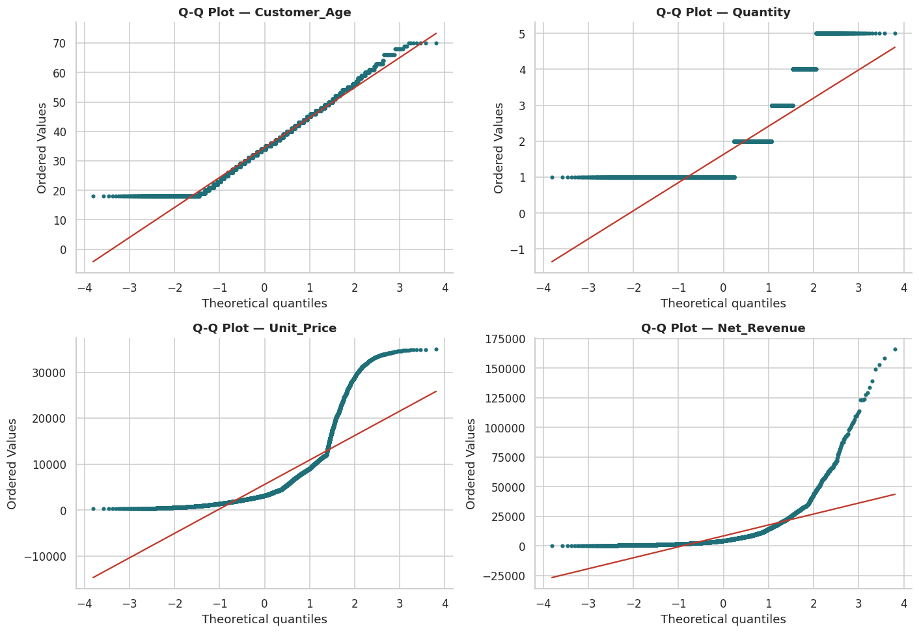
Step 3 - Testing for Normal Distribution
Method: Shapiro-Wilk test + D'Agostino K² test (H0: the variable is normally distributed)
Customer_Age: p = 1.9e-27
Quantity: p = 5.7e-70
Unit_Price: p = 4.4e-71
Net_Revenue: p = 1.6e-76
All p < 0.05
-> Reject H0.
None are normally
distributed.

Slide 6
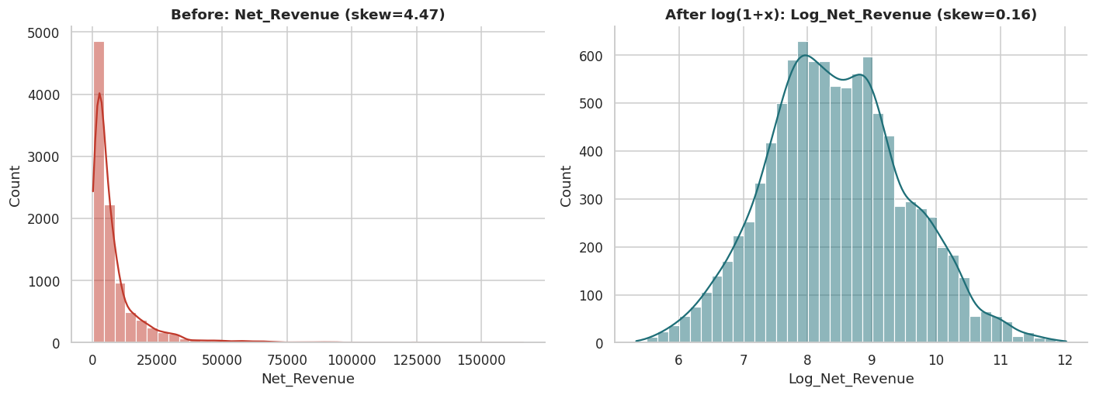
Step 4 - Normalization Applied
Z-score standardisation, Min-Max normalisation, and a log-transform to correct skew
Z-score: mean -> 0, std -> 1 | Min-Max: scaled to [0, 1] | Log(1+x) on Net_Revenue: skewness 4.47 -> 0.16

Slide 7
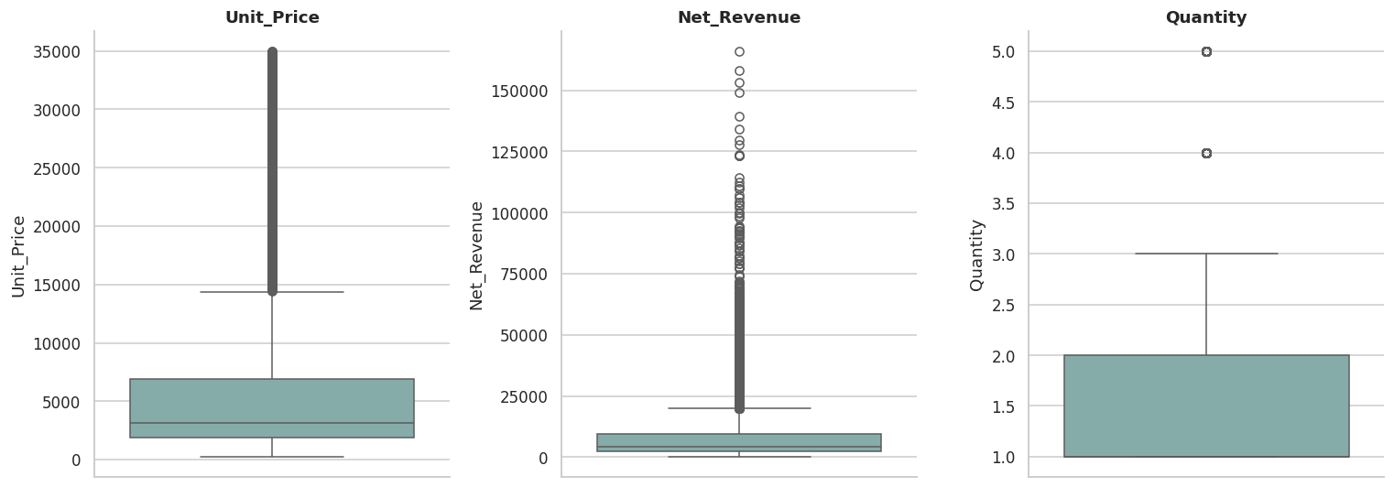
Step 5 - Outlier Detection (IQR Method)
Values beyond Q1 - 1.5xIQR or Q3 + 1.5xIQR flagged for Unit_Price, Net_Revenue and Quantity
Flagged outliers are legitimate high-value orders (furniture/electronics) retained, not deleted.

Slide 8
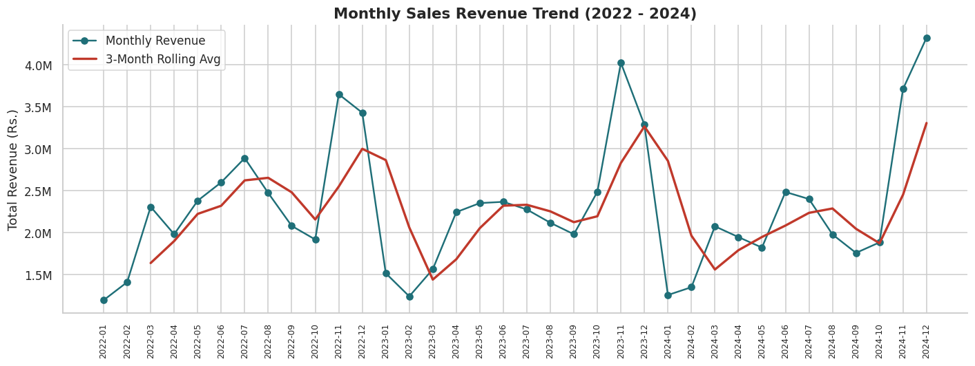
Step 6 - Time Series Analysis
Monthly revenue trend with a 3-month rolling average
Result: revenue spikes every Q4 (Oct-Dec) in all 3 years, with a smaller Jun-Jul lift; Q1 is consistently weakest.

Slide 9
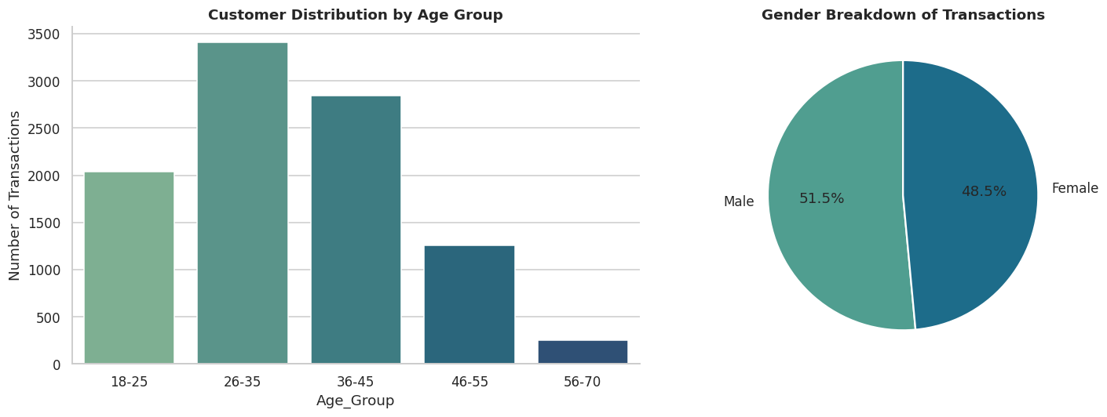
Step 7 - Demographics & Hypothesis Testing
Does gender or age group actually affect average order value?
Levene's Test (Male vs Female)
p = 0.558 -> variances equal
t-test: mean revenue, Male vs Female
p = 0.701 -> NOT significant
Levene's Test (across age groups)
p = 0.632 -> variances equal
ANOVA: mean revenue across age groups
p = 0.365 -> NOT significant
Conclusion: neither gender nor age group is a statistically valid targeting variable for order value in this data.

Slide 10
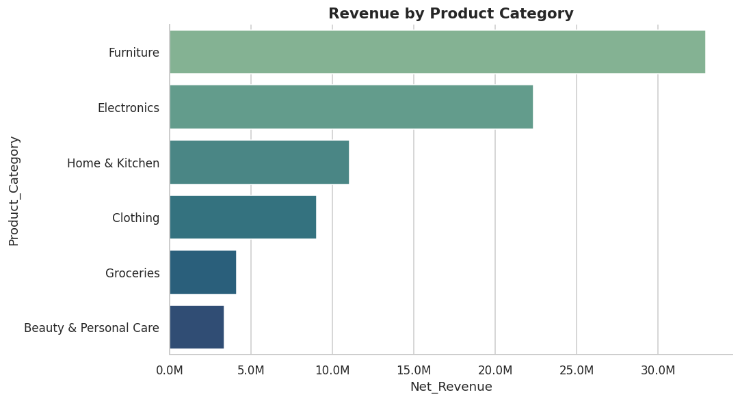
Step 8 - Product Category & ANOVA
Does average order value genuinely differ across product categories?
One-Way ANOVA
F = 2025.2
p < 0.001 (~0)
Reject H0 categories differ significantly in average order value. Furniture & Electronics genuinely command higher order values, not just higher volume.

Slide 11
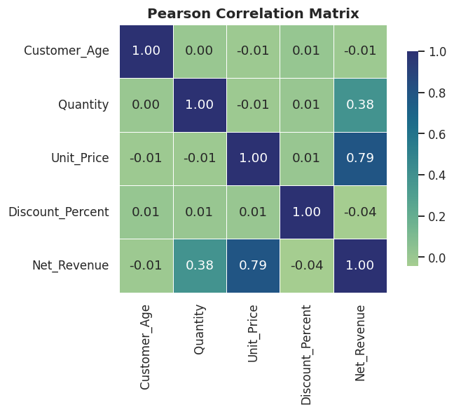
Step 9 - Correlation & Multicollinearity (VIF)
Are the transaction-level predictors redundant with each other?
Feature
VIF
Customer_Age
1.00
Quantity
1.00
Unit_Price
1.00
Discount_Percent
1.00
Rule of thumb: VIF > 5 = concern, VIF > 10 = severe. All features scored ~1.0 -> no multicollinearity; safe to use together in any future model.

Slide 12
Step 10 - Independence Testing (Chi-Square)
Are pairs of categorical fields actually related, or independent?
Pair Tested
Chi² / p-value / Cramer's V
Result
Gender vs Product Category
χ²=5.36, p=0.374, V=0.023
No significant association
Region vs Payment Mode
χ²=20.9, p=0.403, V=0.023
No significant association
Customer Segment vs Category
χ²=28.1, p=0.0017, V=0.038
Statistically significant, but negligible effect size
Note: with ~9,800 rows even a trivial link can be "statistically significant" Cramer's V (effect size) is what confirms whether it's practically meaningful. Here, none are.

Slide 13
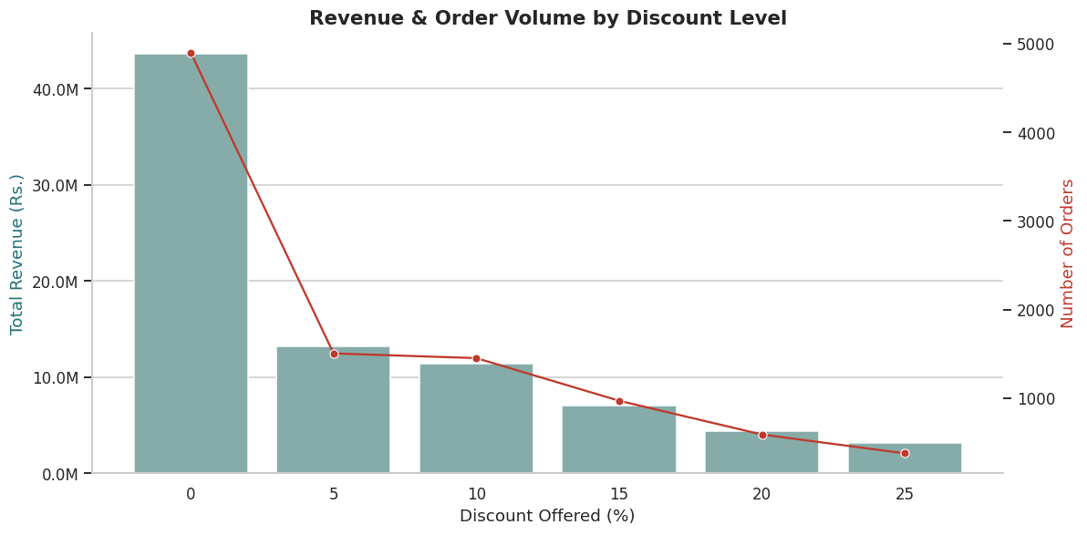
Step 11 - Does Discounting Actually Grow Revenue?
Pearson correlation + One-Way ANOVA across discount tiers
Discount % vs Quantity
(Pearson r)
r = 0.009, p = 0.358
NOT significant
Revenue across
discount tiers (ANOVA)
F = 22.6, p < 0.001
Significant
Reading both together: revenue does shift across discount levels, but bigger discounts don't pull in meaningfully bigger baskets deep discounting looks like a margin cost more than a volume driver.

Slide 14
Conclusion & Recommendations
Grounded directly in the statistical results above
1
Build Q4 inventory (Electronics & Furniture) starting in September; use the confirmed slow Q1 for clearance, not full-price campaigns.
2
Cap standard promotional discounts near 10% ANOVA + correlation results show deeper discounts don't significantly grow basket size.
3
Skip gender-based targeting (t-test: not significant) and instead prioritise the 26-45 age band by transaction volume for retention efforts.

Slide 15
Thank You
Full notebook, dataset, and charts on GitHub - OIBSIP-Data-Analytics/Retail-Sales-EDA
#oasisinfobyte #dataanalytics #internship

